Slide 1
Gamification of Learning
Michael Barshinger

Slide 2
Engagement

Slide 3
G-Word


Slide 4
Game-ification

Slide 5
“Practicing law is serious business, done by serious professionals, and we don’t have time for games.”
-- Partner

Slide 7
Gamification

Engagification
-or-
Reward, Recognition, and Motivation Programs

Slide 8
Gamification 101
Is not about making everything a game
Is not about badges, points, and leaderboards
It can’t fix a bad product

Slide 9
Definition
Gamification - the use of game-psychology and game-mechanics to engage users and change behavior.
Note
Game is not the goal.
Engaging users and changing behavior is the goal.

Slide 10
The Gamer Generation
90m

Slide 11
7 Habits of Highly Successful Gamers
Everyone Can Succeed.
You Gotta Play the Odds.
Learn from the Team, not the Coach.
Trust Strategy Guides.
Watch the Map.
Can’t See It? Ignore It.
Demand the Right Team.

Slide 12
7 Habits of Highly Successful Gamers

Slide 13
1. Everyone Can Succeed
Gamers are extremely optimistic. They believe that everyone can succeed by working hard enough and long enough.

Slide 14
2. You Gotta Play the Odds.
Gamers are twice as likely as Boomers to believe that success is due to luck.
Gamers are more likely to believe, “with a little luck I can be successful without formal training.”

Slide 15
3. Learn from the Team, not the Coach.
Gamers are good a teamwork, often gaming in groups. They learn from each other, not a coach or a teacher.
Recommendation: “Teach” by introducing a problem and then getting out of the way.

Slide 16
4. Kill Bosses, Trust Strategy Guides
Position yourself as someone who has been there and can offer tips. Gamers love strategy guides.
Recommendation: incorporate strategy guides into your offerings
[see handout: quick start guide]

Slide 17
5. Watch the Map.
Gamers function best when they know exactly where they are, where they need to go, and who is ahead of them.
Recommendation: Incorporate learning plans into your training programs

Slide 18
6. Can’t See It? Ignore It.


Slide 19
7. Demand the Right Team.
Gamers seek out other gamers who are at the same skill level. Most gamers don’t like to play with experts or newbies.
Recommendation: If you’re going to “teach” a group by introducing a problem and then getting out of the way, avoid mixing skilled and unskilled people into the same group. Unskilled people learn best when grouped with other unskilled people.

Slide 20
Definition
Gamification - the use of game-psychology and game-mechanics to engage users and change behavior.
Game Mechanics – tools and techniques that can be utilized to build a highly motivational user experience

Slide 21
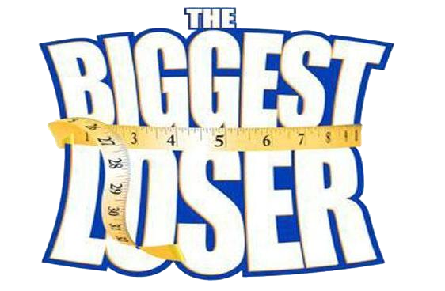
Game Mechanics
Voting

Slide 22
Game Mechanics
Voting
Follow

Slide 23
Game Mechanics
Voting
Follow
Collect

Slide 24
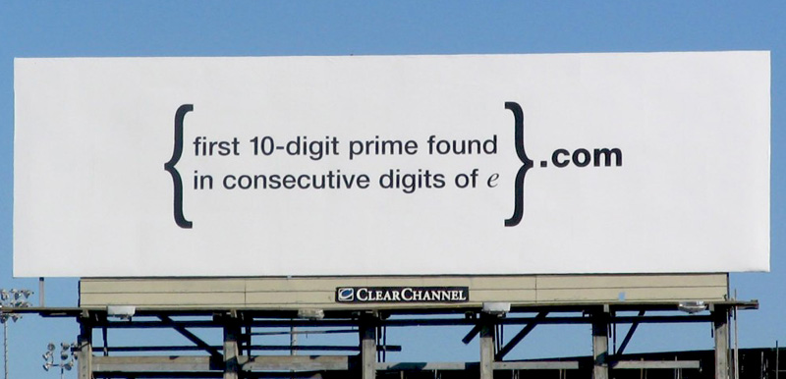
Game Mechanics
Voting
Follow
Collect
Unlock

Slide 25
Game Mechanics
Voting
Follow
Collect
Unlock
Lottery

Slide 26
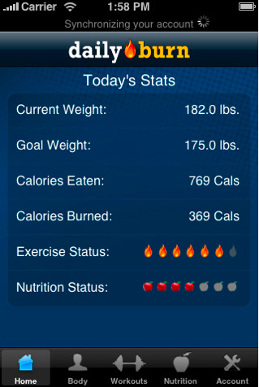
Game Mechanics
Voting
Follow
Collect
Unlock
Lottery
Grades

Slide 27
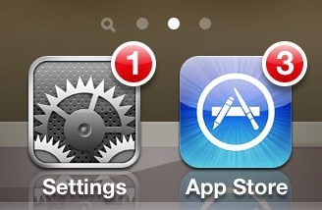
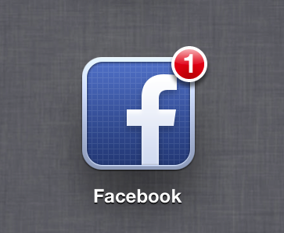
Game Mechanics
Voting
Follow
Collect
Unlock
Lottery
Grades
Clearing

Slide 28
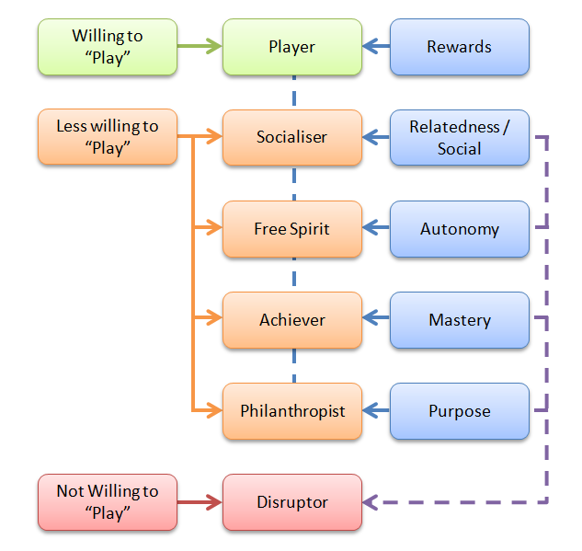
Breakout Session: User Types
http://www.gamified.co.uk/user-types/#.U7wwMvldXDS

Slide 29
Case Study
Introduction of LearningSite

Slide 30
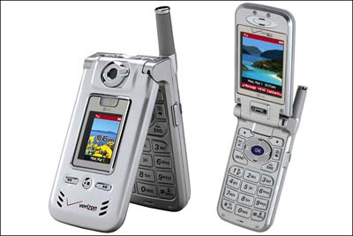
Most popular phone in 2003 – LG 8000

Slide 31
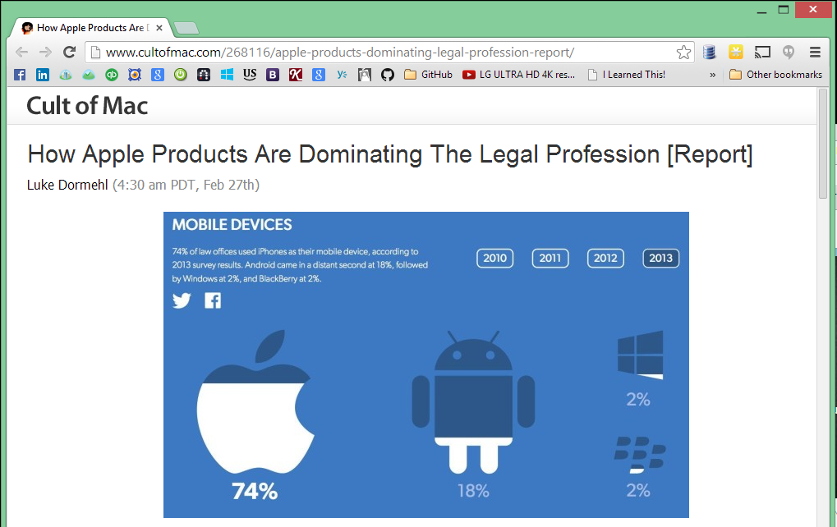

Slide 33
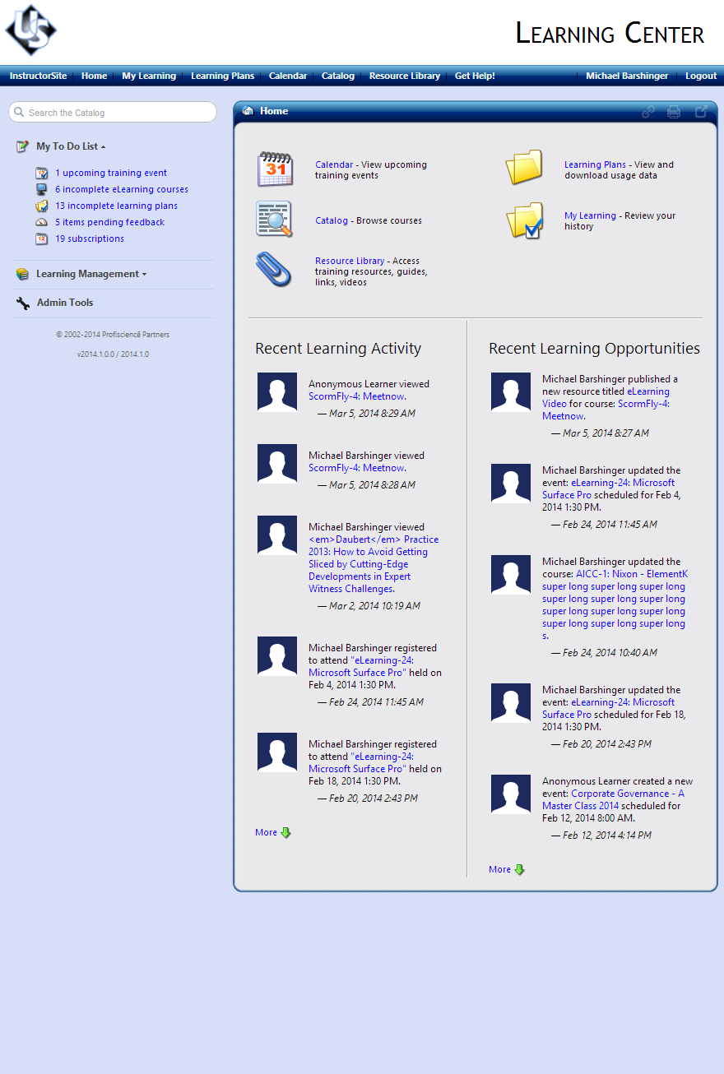
Panning and Zooming

Slide 34
Goals for LearningSite
Mobile – first class citizen
Modern UI – faster, cleaner, simpler, more streamlined
Fewer clicks
Improved search
More customizable, improved branding
Backward compatible

Slide 35
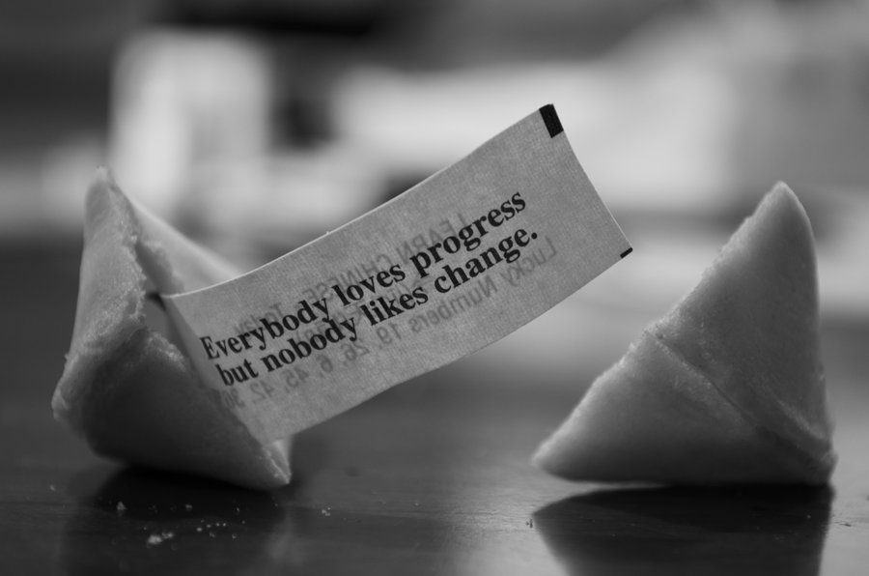

Slide 37
Engagement

Slide 38
LearningSite Adoption and Usage
Gamification
Engagement
Adoption
Usage

Slide 39
Learning Objectives
Change personal settings
Play videos
Register for events
Opt into plans
Request courses
Review achievements
Share videos, events, courses
Sign in from a mobile device

Slide 40
Demo

Slide 41
Breakout Session: Getting Buy-In for Gamification
Put business goals first –think about metrics that management can get behind
Avoid use words like game, gamify, and gamification, use something else like Reward, Recognition, and Motivation Programs

